Slide 1
AI Applications in Marketing & Finance
Interview with Apoorv Saxena
Kartik Hosanagar, Professor of Operations, Information and Decisions

Slide 2
AI Applications in Marketing & Finance
Machine Learning in Finance: Fraud Detection
Kartik Hosanagar, Professor of Operations, Information and Decisions

Slide 3




Credit Card Fraud
Fraud Occurs
Customer Impacted
Dispute Required
Card Replaced
Content/quotes from “Prediction Machines: The Simple Economics of Artificial Intelligence ” by Ajay Agrawal, Avi Goldfarb, and Joshua Gans
Images: https://visualmodo.com/6-security-tips-protect-ecommerce-site/, https://icons8.com/icons/set/phone, https://www.vecteezy.com/vector-art/383180-illustration-of-scissors-cutting-a-credit-card

Slide 4

Credit Card Fraud
Fraud Occurs
ML Detects
Customer Impact Avoided
Card Replaced
Early fraud detection with ML can help prevent fraud and save banks a lot of money
Content/quotes from: “A Human’s Guide to Machine Intelligence” by Kartik Hosanagar, Images: https://visualmodo.com/6-security-tips-protect-ecommerce-site/, https://medium.com/@fenjiro/data-mining-for-banking-loan-approval-use-case-e7c2bc3ece3, https://icons8.com/icons/set/phone, https://www.vecteezy.com/vector-art/383180-illustration-of-scissors-cutting-a-credit-card

Slide 5
ML Model Accuracy is Crucial
False Negatives occur when a business does not detect a transaction as fraudulent and allows the fraudster to make a purchase
The actual cardholder discovers the charge, disputes it, and is usually repaid by the bank
The merchant/bank is responsible for both the cost of the item sold to the fraudster and the associated dispute fees
False Positives occur when a transaction is flagged as fraudulent and blocked, although the potential purchase was actually not fraud
Has an indirect impact by causing reputational damage (this customer may not return; others may hear about people being blocked)
Directly impacts gross profits (loss of this purchase)
Content/quotes from: https://stripe.com/radar/guide

Slide 6
Machine Learning Opportunity
Both supervised and unsupervised learning are used in fraud
Supervised Learning
Unsupervised Learning
Training occurs by using a large dataset with the details of individual transactions provided and with each transaction tagged as fraud or not
From this, the model learns the unique patterns of fraud
Anomaly detection can compare new transactions with prior ones to detect outliers
This can help identify fraud that doesn’t necessarily fit a previously identified pattern (e.g. a new type of fraud)
Content/quotes from: https://stripe.com/radar/guide & https://www.fico.com/blogs/5-keys-using-ai-and-machine-learning-fraud-detection

Slide 7
Supervised Learning Example
Requires input data for training (usually historical data of two types):
“Properties that can be ‘read off’ a single credit card payment
Country the card was issued in, IP address of payment, user’s email domain, etc.
Behavioral data (provides “some of the most predictive signals”)
Number of countries the card was used recently

Slide 8
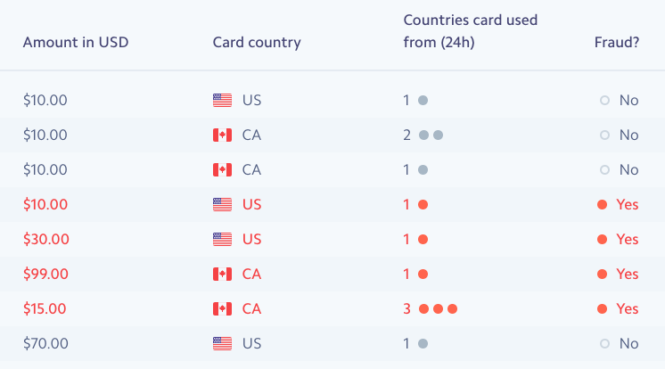
Supervised Learning Example (cont.)
Requires input data for training (usually historical data of two types):
“Properties that can be ‘read off’ a single credit card payment
Behavioral data (provides “some of the most predictive signals”)
Sample Training Data*
* This training data is very limited in order to provide a simple example
To build an accurate model you would need millions of rows as well as additional columns
Content/quotes from: https://stripe.com/radar/guide

Slide 9
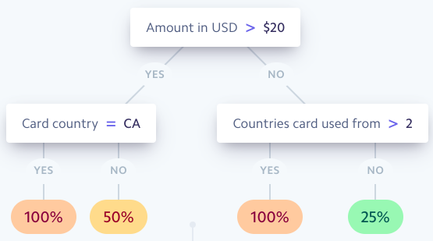
Supervised Learning Example (cont.)
Produces an output model, such as the following decision tree
The tree answers: “of transactions in our data set with properties similar to the transaction we’re examining now, what fraction were actually fraudulent?”
“The machine learning part is concerned with the construction of the tree- what questions do we ask, in what order, to maximize the chances that we can distinguish between the two classes accurately?”
Sample Output*
*This decision tree is based on the same limited data from the previous slide
Content/quotes from: https://stripe.com/radar/guide

Slide 10
Supervised Learning Example (cont.)
Produces an output model, such as the following decision tree
The tree answers: “of transactions in our data set with properties similar to the transaction we’re examining now, what fraction were actually fraudulent?”
“The machine learning part is concerned with the construction of the tree- what questions do we ask, in what order, to maximize the chances that we can distinguish between the two classes accurately?”
Sample Output*
*This decision tree is based on the same limited data from the previous slide
Content/quotes from: https://stripe.com/radar/guide

Slide 11
Supervised Learning Example (cont.)
Produces an output model, such as the following decision tree
The tree answers: “of transactions in our data set with properties similar to the transaction we’re examining now, what fraction were actually fraudulent?”
“The machine learning part is concerned with the construction of the tree- what questions do we ask, in what order, to maximize the chances that we can distinguish between the two classes accurately?”
Sample Output*
*This decision tree is based on the same limited data from the previous slide
Content/quotes from: https://stripe.com/radar/guide

Slide 12
Supervised Learning Example (cont.)
Produces an output model, such as the following decision tree
The tree answers: “of transactions in our data set with properties similar to the transaction we’re examining now, what fraction were actually fraudulent?”
“The machine learning part is concerned with the construction of the tree- what questions do we ask, in what order, to maximize the chances that we can distinguish between the two classes accurately?”
Sample Output*
*This decision tree is based on the same limited data from the previous slide
Content/quotes from: https://stripe.com/radar/guide

Slide 13
Machine Learning Fraud Detection
Supervised Learning: From this (very limited) data, the model would learn a unique pattern of fraud
If >$20 & from Canada, 100% chance of fraud
If <$20 & from >2 countries, 100% chance of fraud
If >$20 & not from CA, or <$20 & from <2 countries, not sure
Unsupervised Learning: Detecting transactions that appear like anomalies
A transaction is for an exceptionally high amount + in a country where this person has not transacted before + in the past, foreign transactions were preceded by flight purchase to that country unlike this time = Anomaly
Content/quotes from: https://stripe.com/radar/guide

Slide 14
Advantages of ML for Fraud
Speed
Scale
Efficiency
Algorithms can quickly process a large volume of transactions
This is important for fraud since a decision is needed in real time
A challenge for humans, but algorithms improve as the amount of data increases.
Machine learning algorithms are better than humans at repetitive tasks
Content/quotes from: https://marutitech.com/machine-learning-fraud-detection/

Slide 15
Limitations of ML for Fraud
Transparency
Data Volume
Algorithms can’t always explain why someone was blocked
Hard to catch issues with the model if it isn’t well understood
Also an ethical problem if biases go undetected (to be discussed in Module 4)
Smaller companies may not have enough training data
Algorithm accuracy might be lower as a result
Content/quotes from: https://marutitech.com/machine-learning-fraud-detection/

Slide 16
AI Applications in Marketing & Finance
Machine Learning in Finance: Additional Applications
Kartik Hosanagar, Professor of Operations, Information and Decisions

Slide 17
Identity Verification & Authentication
ML can improve security through more than just detecting fraud patterns, and it also provides new methods of improving identity verification
Traditional Verification
ML-Based Verification
Passwords
PIN numbers
Biometric authentication using facial and voice recognition technologies
One biometric use case would be when new accounts are opened and customers need to provide multiple forms of ID
Customers could instead provide “selfies” or voice prints, facial recognition and voice recognition technologies can be used to verify identity based on the images/audio provided
ATMs in China are starting to use face recognition
Content/quotes from “Section 2: Known Applications of AI”

Slide 18
Identity Verification & Authentication (cont.)
Biometric authentication can also occur continuously and without intruding into the customer experience - it involves verifying customers’ identities while they are already engaging with the bank through mobile apps
E.g. AI can detect unique biometric patterns of individual customers:
How the person naturally holds a mobile device
How the person taps the screen
Content/quotes from “Section 2: Known Applications of AI”

Slide 19
Identity Verification & Authentication (cont.)
Key Benefits & Limitations of ML for Identity Verification
Benefits
Limitations
Improved security, potentially without creating a cumbersome experience for customers
Not fool proof - attackers could still access biometric identifiers and pose as customers
However, it can still deter attackers
Content/quotes from “Section 2: Known Applications of AI”

Slide 20
Loan & Insurance Underwriting
ML can detect patterns between consumer data and loan or insurance outcomes, and use this to predict the outcomes of particular applicants
E.g., Supervised learning can be used by providing a training dataset with historical data on consumers and their lending/insurance results
Consumer data: age, income, employment, etc.
Lending/insurance results: repaying loans on time vs. defaulting
Content/quotes from: “Section 2: Known Applications of AI”
Additional Content from: https://emerj.com/ai-sector-overviews/machine-learning-in-finance/

Slide 21
Loan & Insurance Underwriting (cont.)
Key Benefits & Limitations of Loans/Insurance Models
Benefits
Limitations
Could reduce processing time
Potential for “increasing loan volume & reducing risk…[by] using more diverse data as well as data with weaker signals.”
Algorithm could be biased and could perpetuate historical discrimination
Companies need to make sure their algorithms don’t discriminate (discussed further in Module 4)
Content/quotes from: “Section 2: Known Applications of AI”
Additional Content from: https://emerj.com/ai-sector-overviews/machine-learning-in-finance/

Slide 22
Predicting Customer Churn
Banks want to retain customers/prevent churn and can apply ML to this goal
In much the same way as with fraud models, the customer data that banks have can be used to “create churn models based on customer attributes or features of those who did or did not churn for another competitor”
Key Benefits & Limitations of Churn Models
Benefits
Limitations
Predictions from churn models are actionable b/c knowing in advance which customers might churn allows banks to make extra efforts to improve those customers’ satisfaction
Predictions about who might churn don’t necessarily provide insight into what is causing them to leave and how best to retain them
Content/quotes from “Section 2: Known Applications of AI”

Slide 23
Three Additional Examples of ML in Finance
Customer Experience
Conversational AI platforms are being used to service customers via chat or over the phone to improve responsiveness and reduce costs
Personal Finance
Personalized portfolios
Financial Forecasting
Ability to predict company financials or budgeting needs in the future
Content/quotes for financial forecasting from “Section 2: Known Applications of AI”
Content/quotes for customer experience and personal finance section from https://www.alacriti.com/machine-learning-in-financial-services-potential-applications/

Slide 24
AI Applications in Marketing and Finance
Introduction
Michael R. Roberts, The William H. Lawrence Professor of Finance

Slide 25
Finance, Data, and Technology
Finance has long been:
Technology oriented
Data oriented
Model oriented

Slide 26
Example Applications
Portfolio management
Algorithmic trading
Fraud detection
Customer retention
Returns forecasting
Earnings forecasting
Credit analysis

Slide 27
What Are We Going to Do?
Focus on an application
Corporate credit risk
Emphasize process
Scientific method
Data science workflow
Emphasize economics
Avoid common pitfalls with models
Illustrate stylized machine learning problem
Imputing credit ratings

Slide 28
How Are We Going to Do it?
Informal delivery
Unscripted
Dynamic
Working together at computer
Thought process is important

Slide 29
Goals
Emphasize importance of
Process
Data
Economic and institutional details
De-emphasize importance of complexity
Black box
Balance 1 and 2

Slide 30
AI Applications in Marketing and Finance
Process: Scientific Method
Michael R. Roberts, The William H. Lawrence Professor of Finance

Slide 31
“
If it (theory) disagrees with experiment, it’s wrong. In that simple statement is the key to science.”
— Richard Feynman

Slide 32
Scientific Method
Clearly articulate a specific question
Guess an answer (hypothesize)
Identify empirical implications of guess
Compare implications with data

Slide 33
AI Applications in Marketing and Finance
Process: Data Science Workflow
Michael R. Roberts, The William H. Lawrence Professor of Finance

Slide 34
Scientific Method
Clearly articulate a specific question
Guess an answer (hypothesize)
Identify empirical implications of guess
Compare implications with data

Slide 35
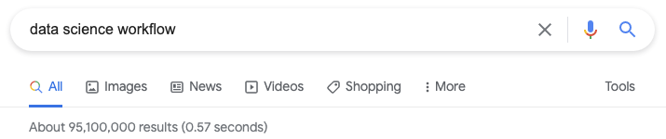
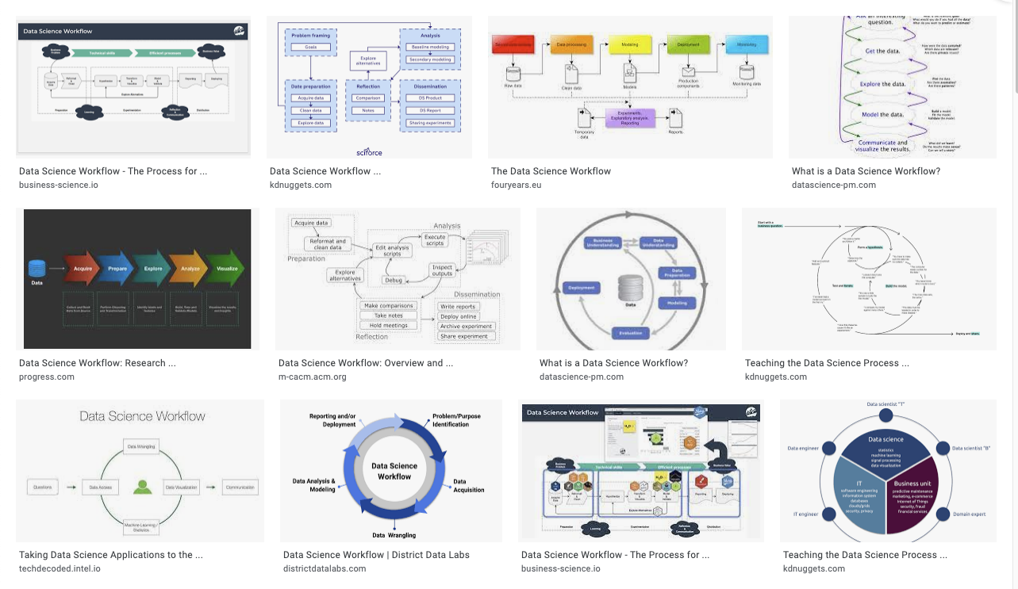
Data Science Workflow

Slide 36
Data Science Workflow
Acquisition and verification
Preparation
Analysis
Communication*
4
1
2
3

Slide 37
AI Applications in Marketing and Finance
Corporate Credit Risk
Michael R. Roberts, The William H. Lawrence Professor of Finance

Slide 38
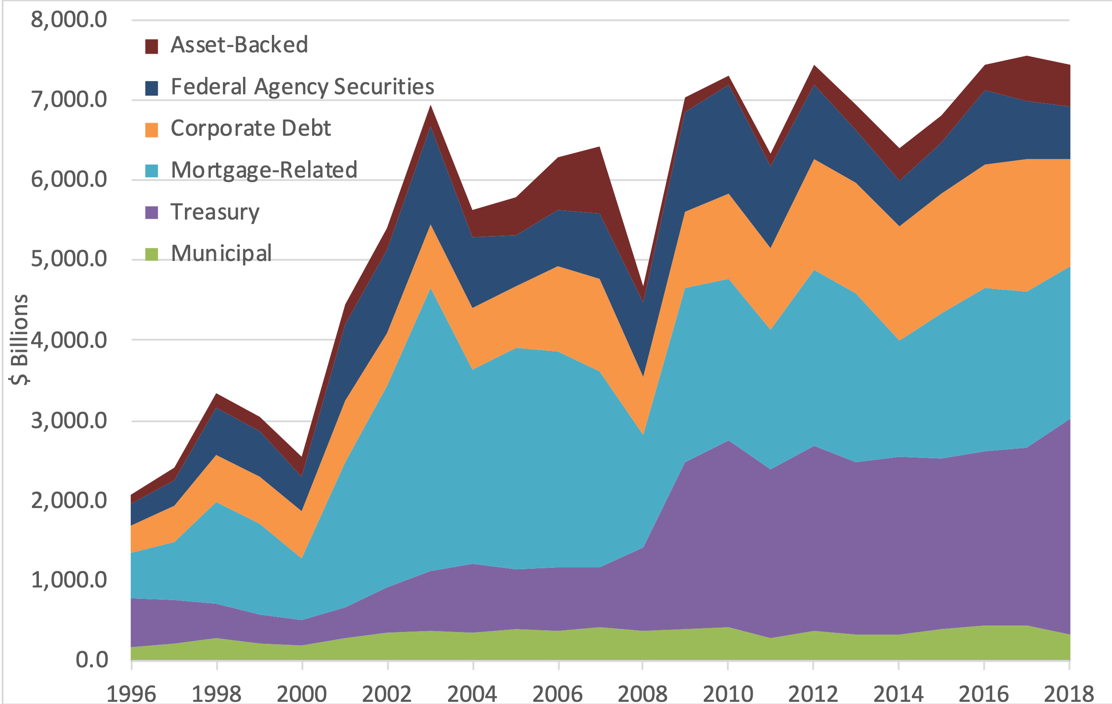
Bond Markets

Slide 39
Bond Markets

Slide 40
Bond Markets

Slide 41
Bond Markets

Slide 42
Bond Markets

Slide 43
Bond Markets

Slide 44
Bond Markets

Slide 45
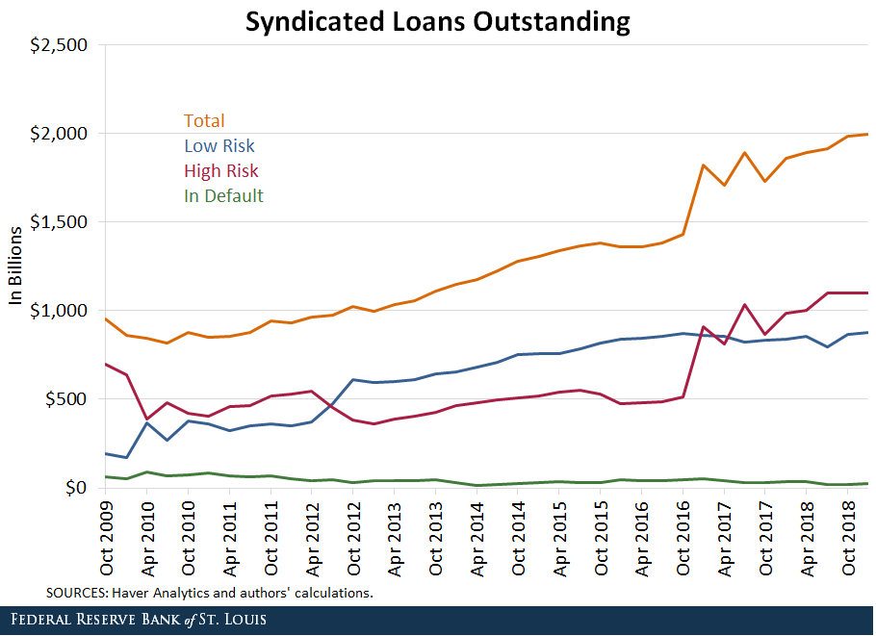
Syndicated Lending

Slide 46
Corporate Credit Risk
What is it?
Inability of firms to repay financial obligations
Why it’s important
Affects availability and price of credit
For whom is it important?
Investors
Employees
Customers
Suppliers
Taxpayers

Slide 47
Outline
Quantify and assess
Examples
Stylized ML example
Predicting credit ratings
Extensions

Slide 48
AI Applications in Marketing and Finance
Credit Risk - KPIs
Michael R. Roberts, The William H. Lawrence Professor of Finance

Slide 49
AI Applications in Marketing and Finance
Credit Risk - Credit Ratings
Michael R. Roberts, The William H. Lawrence Professor of Finance

Slide 50
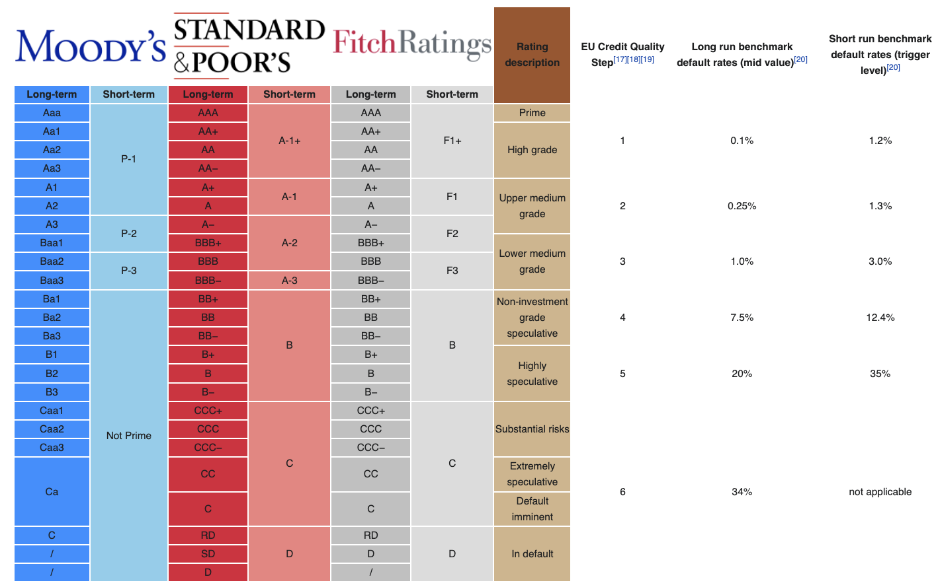
Credit Ratings

Slide 51
Credit Ratings

Slide 52
Credit Ratings

Slide 53
Credit Ratings

Slide 54
Credit Ratings

Slide 55
AI Applications in Marketing and Finance
Credit Risk - Credit Ratings Prediction
Michael R. Roberts, The William H. Lawrence Professor of Finance

Slide 56
Task
Develop model to distinguish between:
Investment-grade
Speculative-grade

Slide 57
Credit Ratings

Slide 58
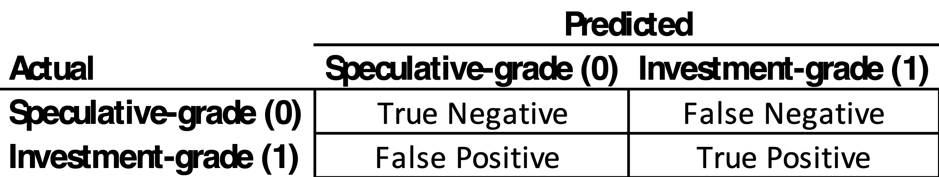
Task
Develop model to distinguish between:
Investment-grade
Speculative-grade
What is success?

Slide 59
Task
Develop model to distinguish between:
Investment-grade
Speculative-grade
What is success?

Slide 60
Task
Develop model to distinguish between:
Investment-grade
Speculative-grade
What is success?

Slide 61
Task
Develop model to distinguish between:
Investment-grade
Speculative-grade
What is success?

Slide 62
Task
Develop model to distinguish between:
Investment-grade
Speculative-grade
What is success?

Slide 63
Task
Develop model to distinguish between:
Investment-grade
Speculative-grade
What is success?

Slide 64
Task
Develop model to distinguish between:
Investment-grade
Speculative-grade
What is success?

Slide 65
Task
Develop model to distinguish between:
Investment-grade
Speculative-grade
What is success?

Slide 66
AI Applications in Marketing and Finance
Credit Risk - Data
Michael R. Roberts, The William H. Lawrence Professor of Finance

Slide 67
Data Science Workflow
Data acquisition and verification
Wharton Research Data Services (WRDS)
S&P Compustat database
Sample
10,540 observations
1995 to 2016
1,400 firms

Slide 68
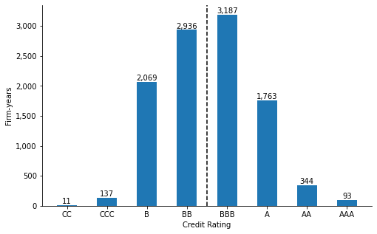
Data Science Workflow
Data preparation
EDA

Slide 69
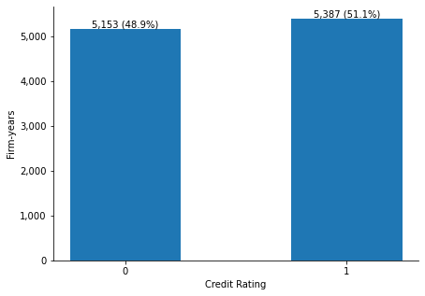
Data Science Workflow

Slide 70
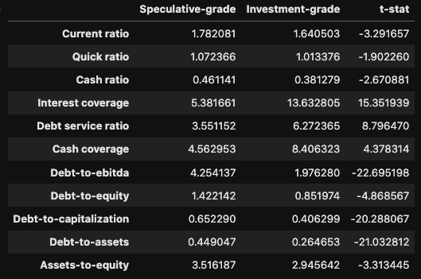
Data Science Workflow

Slide 71
Data Science Workflow

Slide 72
Data Science Workflow

Slide 73
Data Science Workflow

Slide 74
Data Science Workflow

Slide 75
Data Science Workflow

Slide 76
Data Science Workflow

Slide 77
Data Science Workflow

Slide 78
Data Science Workflow

Slide 79
AI Applications in Marketing and Finance
Credit Risk - Model Prep
Michael R. Roberts, The William H. Lawrence Professor of Finance

Slide 80
Model Prep
Y = f(x1, x2, …, xk)
Y = outcome variable = 1 if investment grade, 0 otherwise
(x1, x2, …, xk) = model inputs, predictors, explanatory variables, etc.

Slide 81
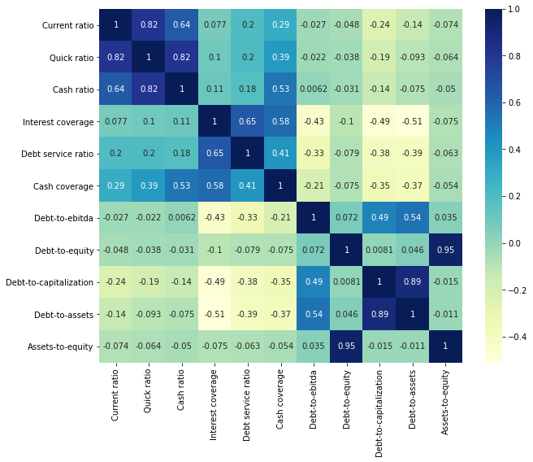
Redundancy?

Slide 82
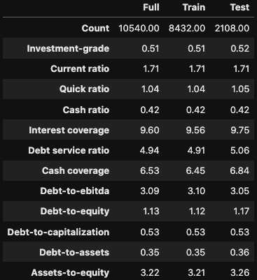
Train-Test Split
Should be done at the very beginning!

Slide 83
AI Applications in Marketing and Finance
Credit Risk - Model Training
Michael R. Roberts, The William H. Lawrence Professor of Finance

Slide 84
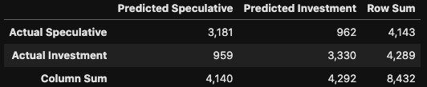
Prediction
Logit model - confusion matrix

Slide 85
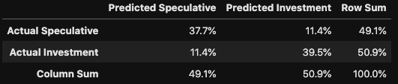
Prediction
Logit model - probability confusion matrix
Model score: 77.2%

Slide 86
Prediction
Logit model - reduced inputs
Current ratio, interest coverage, debt-to-ebitda, debt-to-assets
Model score: 76.5% (77.2%)
Important?

Slide 87
Additional Metrics
Logit model - reduced inputs
Precision = Probability of true positive conditional on positive prediction, 76.54%
Recall = Probability of a true positive conditional on a positive outcome, 77.6%
F1 = Harmonic mean (weighted average of recall and precision), 77.1%

Slide 88
Thoughts
Inspect
(Probability) confusion matrix and model score
Precision, recall, F1 score
What matters depends on the goal set forth at the outset

Slide 89
AI Applications in Marketing and Finance
Credit Risk - Models vs. Data
Michael R. Roberts, The William H. Lawrence Professor of Finance

Slide 90
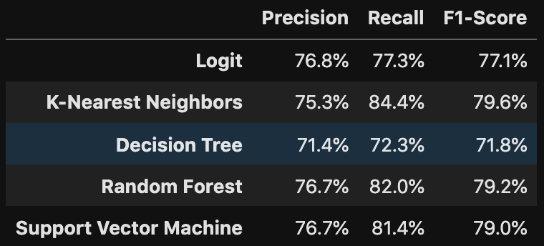
Alternative Models

Slide 91
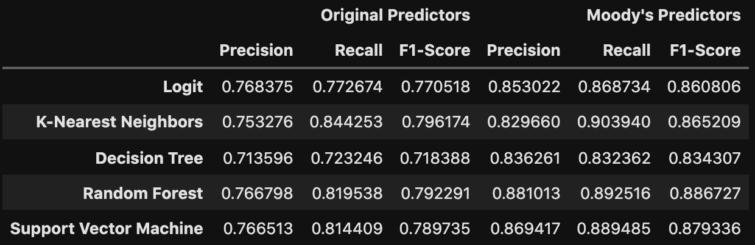
Alternative Models

Slide 92
Alternative Models

Slide 93
Alternative Models

Slide 94
Alternative Models

Slide 95
Alternative Models

Slide 96
AI Applications in Marketing and Finance
Credit Risk - Error Analysis
Michael R. Roberts, The William H. Lawrence Professor of Finance

Slide 97
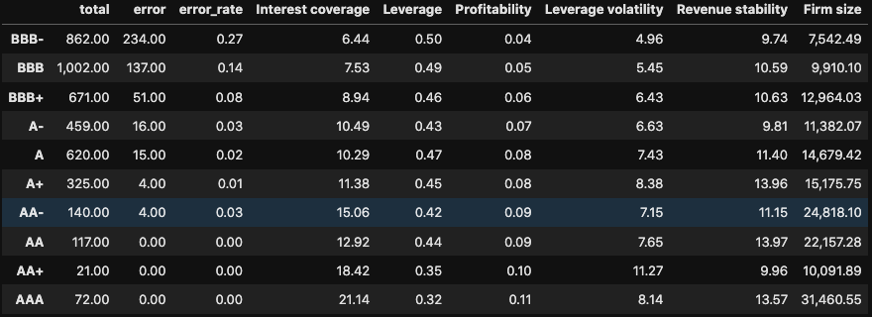
Where’d We Go Wrong?
Inspect errors!

Slide 98
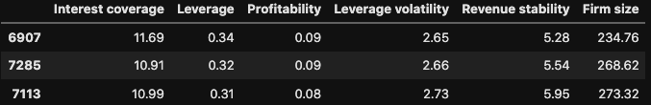
Where’d We Go Wrong?
Misclassified AA- firms = Alltel Pennsylvania in mid 1990s

Slide 99
Where’d We Go Wrong?
Inspect errors!

Slide 100
Where’d We Go Wrong?
Misclassified AA- firms = Alltel Pennsylvania in mid 1990s

Slide 101
Where’d We Go Wrong?
Inspect errors!

Slide 102
Where’d We Go Wrong?
Misclassified AA- firms = Alltel Pennsylvania in mid 1990s

Slide 103
Where’d We Go Wrong?
Inspect errors!

Slide 104
Where’d We Go Wrong?
Misclassified AA- firms = Alltel Pennsylvania in mid 1990s

Slide 105
Where’d We Go Wrong?
Inspect errors!

Slide 106
Where’d We Go Wrong?
Misclassified AA- firms = Alltel Pennsylvania in mid 1990s

Slide 107
Where’d We Go Wrong?
Inspect errors!

Slide 108
Where’d We Go Wrong?
Misclassified AA- firms = Alltel Pennsylvania in mid 1990s

Slide 109
Where’d We Go Wrong?
Inspect errors!

Slide 110
Where’d We Go Wrong?
Inspect errors!

Slide 111
AI Applications in Marketing and Finance
Credit Risk - Concluding Thoughts
Michael R. Roberts, The William H. Lawrence Professor of Finance

Slide 112
Thoughts
Finance — Data — Technology
Scientific method
Data science workflow
Application: Corporate credit risk
Machine learning
Data vs. models
Error analysis
What about AI?

Slide 113


